Slide 1
Week 4 Lecture 2
Modelling solutions to problems
Continued from previous lecture

Slide 2
Problem 5
A new student has just joined the class. Write down the directions for him/her to get to CSG01 from this lecture theatre.
  Swap your solution with the person sitting next to you. If you follow the directions accurately would they take you to CSG01?
  Which set of directions has more detail?
  Is there some confusion?

Slide 3
Writing instructions for computer
Specify solutions in a way the computer understands
  Using a programming language
  Use a formal notation which can be converted into a programming language later.
  We’ve seen these already
    Pseudo-code
    flowcharts

Slide 4
Pseudo-code
Natural language is ambiguous
  Lawyers review legal agreements to ensure it is clear (no ambiguity)
Computer will follow your instructions exactly
There is no specific standard for pseudo-code.
  A combination of natural language (English) and programming syntax

Slide 5
Problem 6
When you pay cash for something you would like to get your change in the minimum number of coins. Write an algorithm in pseudo-code to work out the ideal change to give for any amount between 1 and 99 cent. Suppose the coins available are 1,2,5,10,20,50.

Slide 6
Problem 7
Return to the problem of calculating the average grade/mark for class.
Create your own solution using both a flowchart and pseudo-code.
Consider the solution in the handout

Slide 7
International Standard Book Number (ISBN)
ISBNs are themselves models for books.
A 10-digit ISBN has four parts
  Group code (country of origin/language)
  Publisher code
  Book title
  Check digit
Example
    Raw ISBN: 0140124993
    Hyphenated ISBN: 0-14-012499-3

Slide 8
Problems related to ISBNs
A number of problems related to ISBNs include:
  Validating an ISBN
  Displaying a raw ISBN with the correct hyphenation
See lecture handout for some problems related to ISBNs

Slide 9
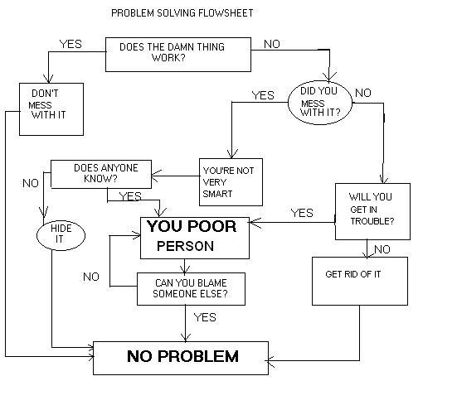
Flowchart example
(adapted from the web)

Slide 10
Links
Understanding flowcharts: http://xkcd.com/518/ (from one of your classmates)

